Slide 1




5.2 Data Mining
Data is gathered at an increasing speed and volume (size doubles each year – Big Data)
4 new petabytes per day (2021)
500 hours of video uploaded every minute (2020)
1 billion tweets each 48 hours (2022) 1st billion took 3 years)
12 EB (12 billion GB) of storage in Utah
Notes:
The growing use of information technology in many domains produces rapidly growing amounts of data in business, science and on the Web. Recently the rate at which digital data is produced started exceeding the amount of storage that can be provided.
These data collections potentially contain a wealth of hidden information, that needs to be discovered. Businesses can learn from their transaction data more about the behavior of their customers and therefore can become more efficient by exploiting this knowledge. Science can obtain from observational data (e.g., satellite data, sensor data) new insights on scientific problems. Web usage data can be analyzed and used to optimize information access, but as well to implement novel business models, such as for advertising on the Web.
The task of extracting useful information from large datasets is called data mining and has in the recent years become one of the most dynamically evolving areas in computer science in general.

Slide 2
Data Mining
Most of this data is useless
pictures of drunk people
videos of cats
royal baby, Justin Bieber
SMS to girlfriend
Notes:
Having increasing amounts of data does not necessarily imply having more useful information.

Slide 3
Data Mining Tasks
But some are interesting
political orientation of people
acts of violence
opinions on products
SMS by a president
Notes:
However, some of the information could be very interesting.

Slide 4
Data Mining Challenge
Transform masses of data into actionable intelligence
From transaction data to market insights
From observational data (satellite, sensors) to new scientific hypothesis
From web usage data to better user interfaces
...
Analysis of large data sets to find relationships and to summarize the data in novel ways that are both understandable and useful
Notes:
The data mining challenging is to extract from large amounts of data, the information that is relevant for performing a given task. That is called actionable intelligence (but has many other names as well, such as business intelligence, market intelligence, open source intelligence, technology intelligence etc). For information to be useful it has to satisfy the following two key criteria:
Understandable: a human should be able to interpret the insights to take decisions
Useful: the insights should help to take decision that have practical impact and utility; this also implies that insights that are not « surprising » but just reproduce existing knowledge are also not very useful.

Slide 5
Tackling the Data Mining Challenge
Practical Questions
Data Access (ownership!)
Domain knowledge (expertise!)
Technical Questions
Data mining: algorithmic approaches to produce insights
(Big) Data management (store, index, retrieve)
Notes:
The challenges to obtain insights with data mining are numerous. The following are some of the key challenges:
The data: often massive amounts of data exist, but are often not easily accessible, protected for legal, organizational, economic or political reasons. Also the data can be distributed over many different systems that are not very accessible.
The questions: searching for insights into data requires to have at least a general idea of what we are looking for, or what could be an interesting and useful insight. Without understanding the objective, it is hard to find useful answers.
The algorithms: Extracting interesting information out of data, requires efficient and smart algorithms. This is what we will study in the following. Once we understand and master such algorithms, the real challenges will be point 1 and 2.
Systems for handling Big Data: this is an area that has made huge progress in the recent years, in particular due to the needs of the big Internet companies. Many of the tools are now available as open source and within the cloud.

Slide 6







Example: Shopping Basket Analysis
Wal-Mart
On Fri afternoon 60% of people who buy diapers also buy beer
Move beer close to diapers to sell more beers!
Association rule mining
Purchase
transactions
Notes:
A classical example of a data mining problem is ”shopping basket analysis". Retail stores gather information on what items are purchased by their customers. The expectation is, by finding out what products are frequently purchased together, identifying ways to optimize the sales of the products by better targeting certain groups of customers (e.g., by planning the layout of a store or planning advertisements). A well-known example was the (presumable) discovery that people who buy diapers also frequently buy beers (probably exhausted fathers of small children). Therefore, nowadays one finds frequently beer close to diapers in supermarkets, and of course also chips close to beer. Similarly, amazon exploits this type of associations in order to propose to their customers books that are likely to match their interests. Searching for methods for address this type of problem was resulting one of the best-known data mining techniques: association rule mining.

Slide 7
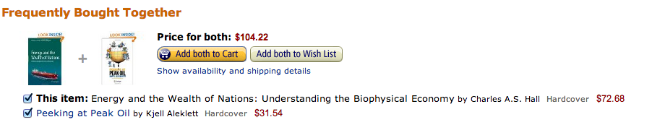
Other Uses for Association Rules
Amazon
Analysis of Query Logs (Query Expansion)
Users that search for “Obama President” often also search for “Obama President Elections”
Notes:
The original term of “shopping basket analysis” does not imply that the resulting methods are limited to analyzing shopping behaviors. The same techniques can and have been applied in many other contexts, including recommender systems, search systems, text analysis, query log analysis etc.

Slide 8
Classes of Data Mining Problems
Local properties
Patterns that apply to part of the data
e.g., buy diapers ➔ buy beers
Global model
Descriptive structure of the data
e.g., 3 types of customer behaviour
Predictive function of the data
e.g., dist(beer, diapers)=1 ➔ +10% beer sales
Notes:
Association rule mining is just one example of a data mining algorithm. Data mining algorithms can in general by classified according the type of models they provide.
A first distinction is made among data mining algorithm that identify global structures of the data, either in the form of summaries of the data or as globally applicable rules, and data mining algorithms that provide models that apply only locally, i.e., to some subset of the data, as patterns or outliers found in the data. The example of association rule mining is a typical case of discovering local patterns.
Data mining algorithms for finding global models of the data can be further distinguished into approaches that are used to characterize the data by identifying some global structure, and into techniques that allow to make predictions on data that has not yet been seen.

Slide 9
Data Mining Overview
Local properties |  | Global model
Patterns |  | Descriptive model | Predictive model
Association rules | Pattern mining | Clustering | Classification
 |  | Information retrieval | Regression
Exploratory data analysis
Interactive tools |  | Visualisation
unsupervised
supervised
Notes:
This graphic shows a basic categorization of different data mining methods. In this categorization we can interpret information retrieval as the use of descriptive models. In addition to purely algorithmic methods, data mining comprises also interactive approaches for exploratory data analysis. This is particularly interesting when the user has no good idea of what data to expect.
Another important categorization of data mining methods is the distinction of unsupervised and supervised methods, as in general for machine learning. In supervised methods the algorithms are provided with data that provides the intended outputs for prediction tasks.

Slide 10
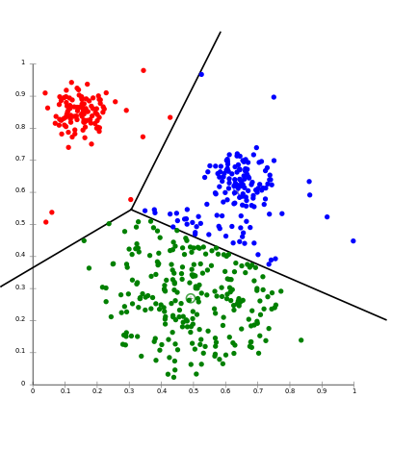
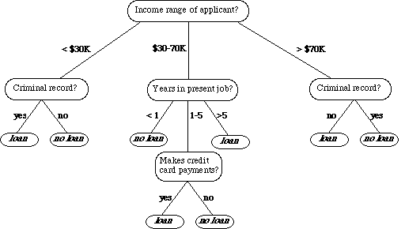
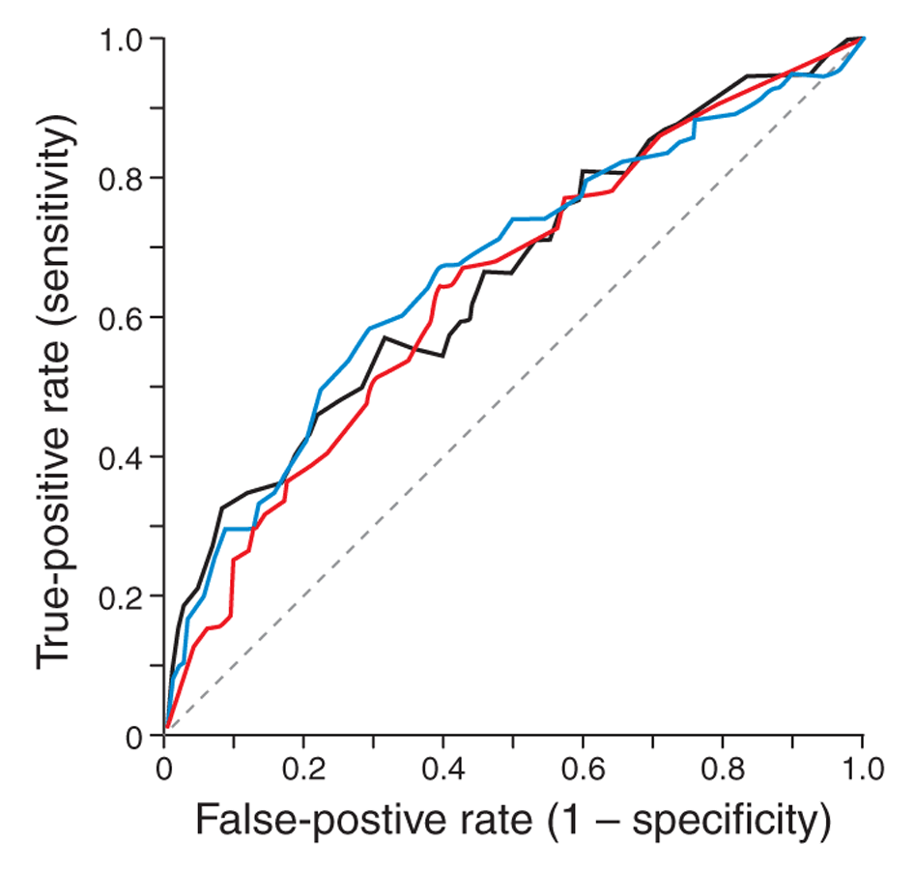
Components of Data Mining Algorithms
Pattern structure/model representation
What we look for?
Scoring function
How well the model fits the data set?
Notes:
Each data mining algorithm can be characterized by four components:
The models or patterns that are used to describe what is searched for in the data set. Typical examples of models are dependencies, clusters and decision trees.
The scoring functions that are used to determine how well a given data set fits the model. In information retrieval these were the different measures used to evaluate the quality of a method, like recall or precision.
The method that is applied in order to identify models from the data set that score well with respect to the scoring function. This requires efficient search algorithms to quickly limit the relevant models based on analyzing the data.
Finally, the scalable implementation of the methods for large data sets. Here indexing techniques and efficient secondary storage management are typically required. This corresponds to the use of inverted files in information retrieval.

Slide 11

Components of Data Mining Algorithms
Optimisation and search
How to tune the parameters of the model? [opt]
How to find data satisfying a pattern? [search]
Data management
How to implement the algorithm for very large data sets?
Notes:
In particular, the aspects of optimization of data search and efficient data management of large dataset delimit data mining from related areas such as statistics and machine learning: data mining algorithms can be understood as statistical or machine learning techniques that scale well to large data sets.

Slide 12
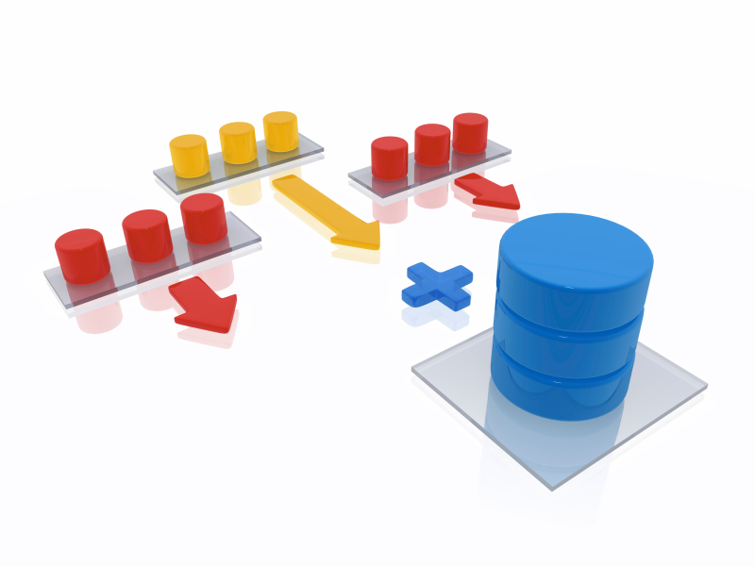



Data Mining System
Databases
(e.g. purchase transactions of different stores)
Data warehouse
(e.g. all purchases in all shops)
Data extraction/integration/ transformation/cleaning
Data selection
Data mart
(e.g. food purchases)
Data analytics
Pattern/model assessment
Notes:
Data mining algorithms are part of data mining system that support the pre-processing of the date and post-processing of the results. A data mining system performs the following typical tasks:
First, the data needs to be collected from the available data sources. Since these data sources can be distributed and heterogeneous databases, database integration techniques are applied. The integrated data is kept in so-called data warehouses or data lakes, databases replicating and consolidating the data from the various data sources. An important concern when integrating the data sources is data cleaning, i.e., removing inconsistent and faulty data as far as possible. The tasks of data integration and data cleaning are supported by so-called data warehousing systems.
Once the data is consolidated in a data warehouse, subsets of the data can be selected from the data warehouse for performing specific data mining tasks, i.e., tasks targeting a specific question. This task-specific data collections are sometimes called data-marts. The data-mart is the database to which the specific data mining algorithm is applied.
The data mining task is the process of detecting interesting patterns in the data. This is what generally is understood as data mining in the narrow sense. We will introduce in the following examples some of the most common techniques that are used to perform this task (e.g., association rule mining).
Once specific patterns are detected they can be further processed. Further processing may include the evaluation of the "interestingness” of patterns for the specific problem at hand and the implementation of actions to react on the discovery of a pattern.
Each of the steps described can influence the other steps. For example, patterns or outliers detected during data mining may indicate the presence of erroneous data, rather than interesting features in the source databases. This may imply adaptations of the data cleaning process during data integration.

Slide 13
Data Mining ≠ Machine Learning
What is in common
In DM for data analytics frequently typical ML methods are used, though not always (e.g., visual mining, simple statistics)
What is different
Data: DM is always applied to large datasets, ML not (e.g., reinforcement learning)
Scope: DM comprises of the whole process of data integration, cleaning, analysis
Goal: DM aims at detecting unsuspected patterns, ML may have other goals (e.g., winning a game)
Notes:
Often data mining and machine learning are used like synonyms. Though both are exploiting the same algorithmic techniques, they can have different scope and goals. In particular, data mining is specifically targeted at analysis of large datasets and concerned with the resulting performance questions.

Slide 14
Detecting unusual behaviours in network logs is typically done by using
local rule discovery
predictive modelling
descriptive modelling
exploratory data analysis
all of these methods can be applied

Slide 15
Example: Shopping Basket Analysis
Wal-Mart
On Fri afternoon 60% of people who buy diapers also buy beer
Move beer close to diapers to sell more beers!
Purchase
transactions
Notes:
The classical example of a data mining problem is "market basket analysis". Retail stores gather information on what items are purchased by their customers. The expectation is, by finding out what products are frequently purchased together (i.e., are associated with each other), identifying ways to optimize the sales of the products by better targeting certain groups of customers (e.g., by planning the layout of a store or planning advertisements). A well-known example was the discovery that people who buy diapers also frequently buy beers (probably exhausted fathers of small children). Therefore, nowadays one finds frequently beer close to diapers in supermarkets, and of course also chips close to beer. This type of problem was the starting point for one of the best-known data mining techniques: association rule mining.

Slide 16
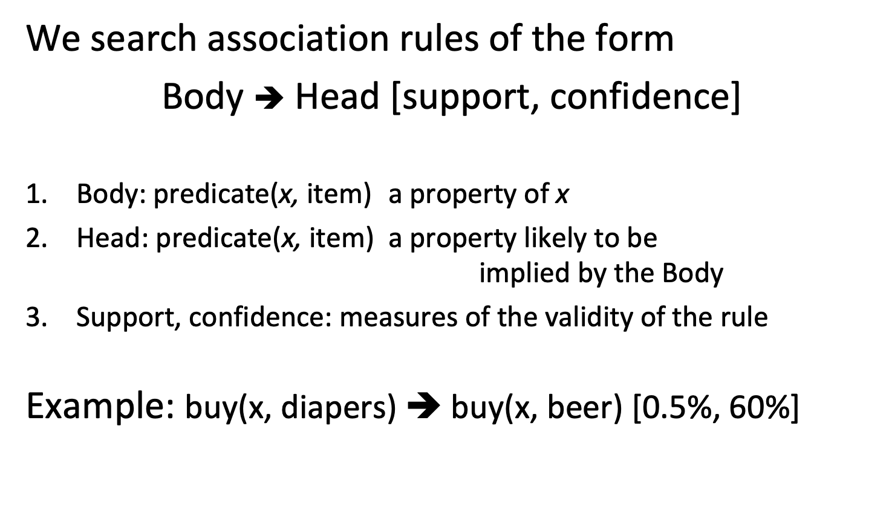
5.2.1 Association Rules
We search association rules of the form
Body ➔ Head [support, confidence]
Body: predicate(x, item) a property of x
Head: predicate(x, item) a property likely to be implied by the Body
Support, confidence: measures of the validity of the rule
Example: buy(x, diapers) ➔ buy(x, beer) [0.5%, 60%]
Notes:
Association rule mining is a technique for discovering unsuspected data dependencies and is one of the best-known data mining techniques. An association rule captures dependencies of different properties of an entity, denoted by x. For shopping basket analysis, the entity would be a shopping basket. The properties are expressed as predicates involving some items. The resulting rules state that if the entity has the property stated in the body, then the entity has also the property stated in the head with the probability stated by the confidence. The support expresses additionally how well-founded the rule is. We will introduce later in detail how these measures are defined.
In principle, such rules could be easily found by an exhaustive exploration of all possible dependencies, which is however prohibitively expensive. Association rule mining thus solves the problem of how to search efficiently for those dependencies.

Slide 17
Single- and Multi-dimensional Rules
Single-dimensional rules
buy(x, diapers) ➔ buy(x, beer) [0.5%, 60%]
Multi-dimensional rules
age(x, 19-25) ∧ buy(x, chips) ➔ buy(x, coke) [10%, 75%]
Notes:
In the simplest case association rules use only a single predicate, such as buy. It is not hard to imagine that also other properties of the entities could be used in rules. For example, in the shopping basket example the age of the buyer could be another property of the shopping basket. Then we are talking about multi-dimensional rules.

Slide 18
From Multi- to Single-dimensional Rules
Use predicate/value pairs as items
age(x, 19-25) ∧ buy(x, chips) ➔ buy(x, coke)
customer(x, age=19-25) ∧ customer(x, buy=chips) ➔ customer(x, buy=coke)
Simplified notation of single-dimensional rules
{diapers} ➔ {coke}
{age=19-25, buy=chips} ➔ {buy=coke}
Notes:
However, it is straightforward to transform multi-dimensional association rules into single-dimensional rules, by combining predicate names and values into a new set of items of uniform type, consisting of predicate/value pairs. Therefore, we need to consider in the following only the case of single-dimensional rules. Since for similar rules there is only a single predicate applied to the entities, we can simplify the notation by dropping this predicate at all, and simply list the set of items in the body and head of the rules. This results in the usual notation adopted for association rules that captures dependencies among sets of items, or itemsets as they are usually called.

Slide 19
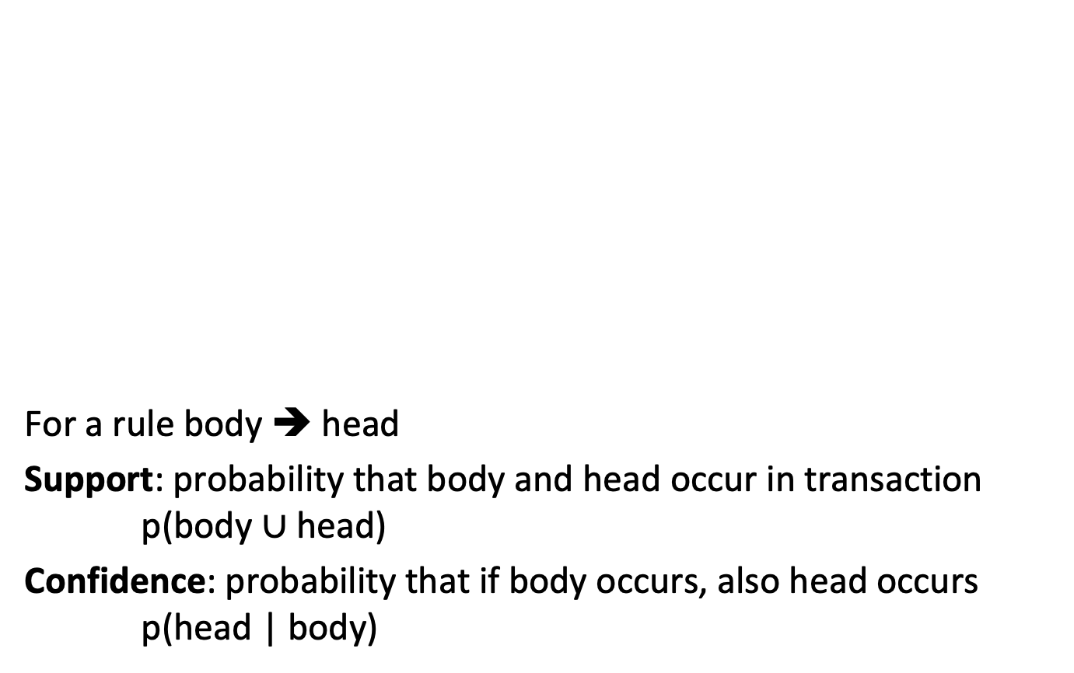
Basic Concepts
For a rule body ➔ head
Support: probability that body and head occur in transaction p(body $∪$ head)
Confidence: probability that if body occurs, also head occurs p(head | body)
Customer
buys both
Customer
buys diaper
Customer
buys beer
Notes:
Association rule mining uses as input a set of transactions that consist of itemsets. We can illustrate the relationships among items using Venn diagrams. Each subset of the diagram represents a set of transactions containing some itemset or item. The measures of support and confidence for a rule body -> head are then defined as follows. The support gives the probability that a transaction contains all the items occurring in the rule, i.e., the probability that both all items of the body and of the head occur in the transaction. In other words, this is the probability that the rule applies to a transaction. The confidence is the probability that if the items of the body of a rule occur in the transaction, then also the items in the head of the rule occur in the transaction. In other words, this is the probability that the rule makes a correct prediction. The support expresses of how many relevant transactions exist for a rule, and therefore how well-founded it is, whereas the confidence expresses how reliable a rule is.

Slide 20
Support and Confidence
Rule 1: {beer} ➔ {diaper} Rule 2: {diaper} ➔ {beer}
p({beer, diaper})=2/4 p({diaper, beer})=2/4
p({diaper} | {beer})=2/3 p({beer} | {diaper})=2/2
{beer} ➔ {diaper}[50%, 66%] {diaper} ➔ {beer}[50%, 100%]
Notes:
Here we compute support and confidence for two different rules.

Slide 21
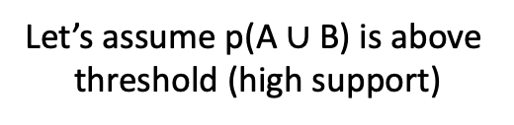
Support and Confidence
Let’s assume p(A $∪$ B) is above threshold (high support)
conf(A ➔ B): high conf(A ➔ B): low
conf(B ➔ A): low conf(B ➔ A): low
conf(A ➔ B): low conf(A ➔ B): high
conf(B ➔ A): high conf(B ➔ A): high
B
A
B
A
A
A
B
B
Notes:
Considering two itemsets A and B, we can define one association rule for each direction, A->B and B->A. Assuming that the support for the union of items in A and B is high, we can find 4 different combinations for the confidence of the two possible rules. This shows that an association rule is indeed directed, and not necessarily symmetric. A directed association rule, which is in general the interesting case, is related to an approximate subset relationship of the corresponding transaction sets.

Slide 22
Definition of Association Rules
Terminology and Notation
Set of all items I, subset of I is called itemset
Transaction (tid, T), T ⊆ I itemset, transaction identifier tid
Set of all transactions D (database), Transaction T ∈ D
Association Rules A ➔ B [s, c]
A, B itemsets (A, B ⊆ I)
A ∩ B empty
s(A ➔ B ) = s(A ∪ B) = p(A ∪ B) = count(A ∪ B) / |D| (support)
c(A ➔ B) = p(B | A) = s(A ∪ B) / s(A) (confidence)
Notes:
Here we summarize the concepts and notations that are used for specifying and characterizing association rules. Association rules are defined for itemsets that are subsets of set of times. They are defined with respect to a set of transactions that are itemsets. The rules are defined such that the body and head of the rule have empty intersection. The support is defined as the probability of the union of the body and head to occur in a transaction. This probability is computed by counting the number of transactions that contain those items. The confidence is the conditional probability of the head of the rule occurring, given the body. This probability can be computed from the support of the rule, and the support of the body.

Slide 23
10 itemsets out of 100 contain item A, of which 5 also contain B. The rule A ➔ B has:
5% support and 10% confidence
10% support and 50% confidence
5% support and 50% confidence
10% support and 10% confidence

Slide 24
10 itemsets out of 100 contain item A, of which 5 also contain B. The rule B ➔ A has:
unknown support and 50% confidence
unknown support and unknown confidence
5% support and 50% confidence
5% support and unknown confidence

Slide 25
Association Rule Mining: Problem
Problem
Given a database D of transactions (tid, T)
Find
all rules A ➔ B [s, c]
such that s > s_{min} (high support)
and c > c_{min} (high confidence)
Notes:
The problem of mining association rules is now defined as follows: Given a database of transactions, find all rules that correlate the presence of one itemset with that of another itemset where the support and the confidence are above a given threshold. In other words, find all association rules that have high support and confidence.

Slide 26
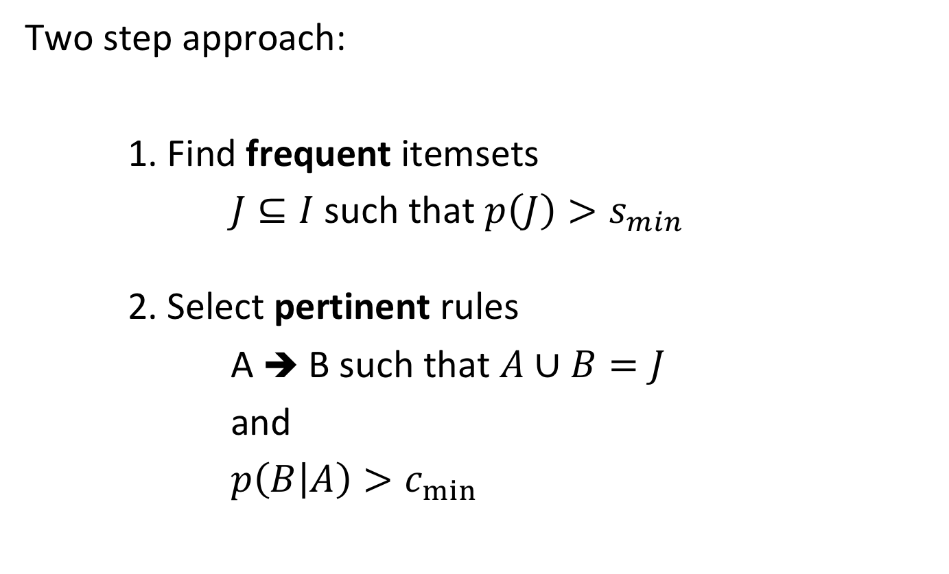
5.2.2 Apriori Algorithm
Two step approach:
1. Find frequent itemsets
$J⊆I$ such that $p\left(J\right)>s_{min}$
2. Select pertinent rules
A ➔ B such that $A∪B=J$
and
$p\left(B | A\right)>c_{min}$
Notes:
We will approach the problem in two steps, by first considering only the problem of finding itemsets that satisfy the condition on having a high support, which is a necessary condition for a rule to be an association rule, and then extracting from those itemsets the rules that have a high confidence. We have already noticed in the confidence value can be computed from support values of itemsets. Thus it is natural to first identify itemsets with high support.

Slide 27
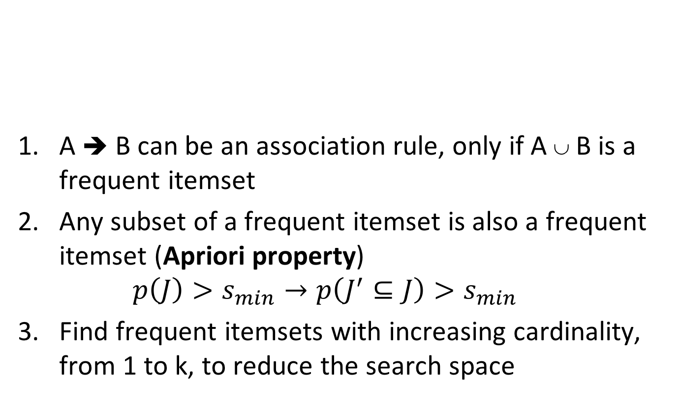
Frequent Itemsets
Frequent Itemset | Support
{beer} | 0.75
{milk} | 0.75
{diaper} | 0.5
{beer,milk} | 0.5
{beer, diaper} | 0.5
{milk, diaper} | 0.25
A ➔ B can be an association rule, only if A ∪ B is a frequent itemset
Any subset of a frequent itemset is also a frequent itemset (Apriori property) $p\left(J\right)>s_{min}→p\left(J^{′}⊆J\right)>s_{min}$
Find frequent itemsets with increasing cardinality, from 1 to k, to reduce the search space
Notes:
A necessary condition for finding an association rule of the form A->B is that it has a sufficiently high support. Therefore, for finding such rules, we can first identify itemsets within the transactions that occur sufficiently frequent. These are called frequent itemsets. Second, we can observe that any subset of a frequent itemset is necessarily also a frequent itemset. This is called the apriori property. The a priori property is the central idea in the algorithm we will introduce in the following. It will be used for multiple purposes. A first use of this property is the observation that we can search for frequent itemsets by searching them by increasing cardinality: once frequent itemsets of lower cardinality are found, only itemsets of larger cardinality need to be considered that contain one of the frequent itemsets already found. This allows us to dramatically reduce the search space.

Slide 28
Exploiting the Apriori Property
If we know all frequent (k-1)-itemsets, which are candidate frequent k-itemset X?
Any (k-1)-itemset that is subset of X must be frequent
Any ordered (k-1)-itemset that is subset of X must be frequent
In particular, two ordered (k-1)-itemsets that are subsets of X and differ only in their last position must be frequent
Notes:
Assume that we know frequent itemsets of size k-1 and want to construct an itemset of size k (a k-itemset). What properties does such a k-itemset have to satisfy? We can say, that any subset of size k-1 must be frequent. We can also order those subsets by their elements. We can that even say that two ordered subsets that differ only in the last position must be frequent. This gives is now a possibility to construct k-itemsets systematically.

Slide 29
Exploiting the Apriori Property: Candidates
A
B
C
D
Frequent k-itemset
A
B
C
A
B
D
Frequent (k-1)-itemset
Frequent (k-1)-itemset
The union of two (k-1)-itemsets that differs only by one item is a candidate frequent k-itemset
Notes:
If two ordered subsets of size k-1 of a frequent itemset of size k that differ only in the last position must be frequent, we can invert the argument. Assume we know all frequent itemsets of size k-1 then, then the itemset of size can only be frequent if it can be constructed from two k-1 itemsets in exactly this way. An itemset of size k constructed this way is then called a candidate frequent k-itemset. We do not know whether it is frequent indeed. The construction is a necessary condition, but not a sufficient one.

Slide 30
Example
Frequent Itemset | Support
{beer} | 0.75
{milk} | 0.75
{diaper} | 0.5
{beer,milk} | 0.5
{beer, diaper} | 0.5
{milk, diaper} | 0.25
{beer} and {milk} differ by one item, thus {beer,milk} is a candidate 2-itemset
{beer, milk} and {beer, diaper} differ by one item, thus {beer, diaper, milk} is a candidate 3-itemset
Notes:
Note that the candidate itemsets generated by the join step are not necessarily frequent itemsets, as the example illustrates.

Slide 31
Exploiting the Apriori Property: JOIN step
Given the frequent (k-1)-itemsets, L_{k-1}, we can construct a candidate set C_{k} by joining two (k-1)-itemsets that differ by exactly 1 item in the last position
Algorithm (JOIN)
Sort the itemsets in L_{k-1}
Find all pairs with the same first k-2 items, but different k-1th item
Join the two itemsets in all pairs and add to C_{k}
Notes:
In order to create candidates efficiently we consider only one specific way of constructing candidates. We only combine itemsets that have the first k-2 elements identical and differ in their last position. If a k-itemset is frequent it necessarily is (also) constructed this specific way.
For example, if we have
ABC
ACD
BCD
If we combine ACD and BCD (which also differ by one item) we would get ABCD. But ABCD have been already generated by combining ABC and ABD.

Slide 32
JOIN step: Example
L₂
itemset
C₃
itemset
{1 2}
{1 3} {1 5} {2 3} {2 4} {2 5}
{1 2 3}
{1 2 5} {1 3 5} {2 3 4} {2 3 5} {2 4 5}
join
Notes:
Here we illustrate the join step for itemsets of size 2, to construct itemsets of size 3. Only pairs of itemsets of size 2 are considered that coincide in their first position.

Slide 33
Exploiting the Apriori Property: PRUNE Step
A k-itemset in the candidate set C_{k} might still contain (k-1)-itemsets that are not frequent (k-1)-itemsets
Eliminate them (PRUNE)
L₂
itemset
C₃
itemset
C₃
itemset
{3 5}
{1 2}
{1 3} {1 5} {2 3} {2 4} {2 5}
{1 2 3}
{1 2 5} {1 3 5} {2 3 4} {2 3 5} {2 4 5}
{1 2 3}
{1 2 5} {1 3 5} {2 3 4} {2 3 5} {2 4 5}
join
prune
{3 4}
{3 5}
{4 5}
Notes:
The k-itemsets constructed in the join step are not necessarily frequent k-itemsets. One possible reason is that they contain some subsets of items which are not a frequent itemset. These can be eliminated in a prune step. By checking if every (k-1) itemset of a candidate itemset is indeed a frequent (k-1) itemset some of the candidate itemsets can be eliminated.

Slide 34
Final Step
For the remaining k-itemset in the candidate set C_{k} eliminate those that are not frequent by counting how often they occur in the database
The final step is the most expensive (full access to database D)
Advantage: Performed only for a smaller number of candidate itemsets, reduced by JOIN and PRUNE
Notes:
After the prune step is completed, still the remaining candidates can be non-frequent. Therefore, the frequency of these itemsets needs to be determined by accessing the database and counting the number of their occurrences. An important aspect of the apriori algorithm is that this last step is the most expensive one, since it requires access to the complete database. By performing the join and prune steps the operation needs to be performed only for a reduced number of itemsets.

Slide 35
Apriori Algorithm
k := 1, L_{k} := { J ⊆ I : |J|=1 ∧ p(J) > s_{min} } //frequent items
while L_{k} != ∅
C’_{k+1} := JOIN(L_{k}) // join itemsets in L_{k} that differ by one element
C_{k+1} := PRUNE(C’_{k+1}) // remove non-frequent itemsets
for all (id,T) ∈ D // compute the frequency of candidate
for all J ∈ C_{k+1} , J ⊆ T
count(J)++
end for
end for
L_{k+1} := { J ⊆ C_{k+1} : p(J) > s_{min} } // add candidate frequent itemsets
k := k+1
end while
return ∪_{k} L_{k}
Notes:
This is the summary of the complete apriori algorithm.

Slide 36
D
C₁
L₁
s_{min}= 0.5
Scan D
Join + Prune
L₂
C₂
C₂
Scan D
Join + Prune
C₃
Scan D
L₃
Notes:
Here we give a complete example of the exection the apriori algorithm. Notice, in this example, how the scan steps (when determining the frequency with respect to the database) eliminate certain itemsets. Pruning does not lead to any elimination of itemsets in this example. The algorithm built 9+3 (frequent + non frequent) = 12 itemsets out of 2⁵ = 32 total possible itemsets

Slide 37
Select pertinent rules
R := ∅ // initial set of rules
L := Apriori(D) // set of frequent itemsets
for all J ∈ L
for all A ⊆ J, A != ∅
r := A ➔ J \ A // create candidate rule
if c(A ➔ J \ A) = s(J)/s(A)> c_{min}
R := R ∪ r
end if
end for
end for
Notes:
Once the frequent itemsets are found with the apriori algorithm, the derivation of relevant association rules is straightforward. One checks for every frequent itemset whether there exists a subset A that can occur as the body of a rule. For doing that, the support count, i.e., the frequency of the itemset in the database, which was obtained during the execution of the Apriori algorithm, is used to compute the confidence as a conditional probability. Note that also L\A is a frequent itemset, and therefore the support count is available for that set as well from the apriori algorithm.
Note that c(A ➔ J \ A) = s((J\A) ∪ A)/s(A) = s(J)/s(A) .

Slide 38
c_{min}= 0.75
J={1,3}
A={1}, J\A={3} {1} ➔ {3} c = sup({1,3})/sup({1}) = 1 OK
A={3}, J\A={1} {3} ➔ {1} c = sup({1,3})/sup({3}) = 0.66 KO
J={2,3,5}
A={3,5}, J\A={2} {3,5} ➔ {2} c = sup({2,3,5})/sup({3,5}) = 1 OK
A={2}, J\A={3,5} {2} ➔ {3, 5} c = sup({2,3,5})/sup({2}) = 0.66 KO
Notes:
Here we illustrate the extraction of association rules using the known set of frequent itemsets.

Slide 39
Given the frequent 2-itemsets {1,2}, {1,4}, {2,3} and {3,4}, how many 3-itemsets are generated and how many are pruned?
2, 2
1, 0
1, 1
2, 1

Slide 40
After the join step, the number of k+1-itemsets ...
is equal to the number of frequent k-itemsets
can be equal, lower or higher than the number of frequent k-itemsets
is always higher than the number of frequent k-itemsets
is always lower than the number of frequent k-itemsets

Slide 41
If rule {A,B} ➔ {C} has confidence c₁ and rule {A} ➔ {C} has confidence c₂, then ...
c₂ >= c₁
c₁ > c₂ and c₂ > c₁ are both possible
c₁ >= c₂

Slide 42
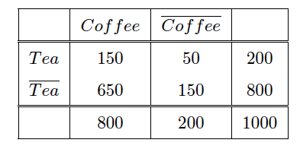
Interesting Association Rules
Not all high-confidence rules are interesting
{Tea} ➔ {Coffee} has support 0.15 and confidence 0.75
But 80% of people drink coffee anyway
Drinking tea decreases the probability to drink coffee!
Notes:
High confidence and support do not necessarily imply that a rule is interesting or useful. We illustrate this by the following example. The matrix indicates the number of entities that like or do not like coffee or tea. If we consider the rule {Tea} –> {Coffee} we will find that it has support 0.15 and confidence 0.75, which we may consider as very high. At the first glance this looks like a good rule. Looking more carefully, we will realize that in fact 80% of people drink coffee. In view of this, the rule just holds, because people in general drink a lot of coffee. Even worse, considering that 80% of people drink coffee, among the people drinking tea the propensity to drink coffee is less pronounced, only 75%. In conclusion, drinking tea has a negative impact on drinking coffee which is the opposite to what the rule suggests. This motivates the need for alternative measures to evaluate whether a rule is interesting.

Slide 43
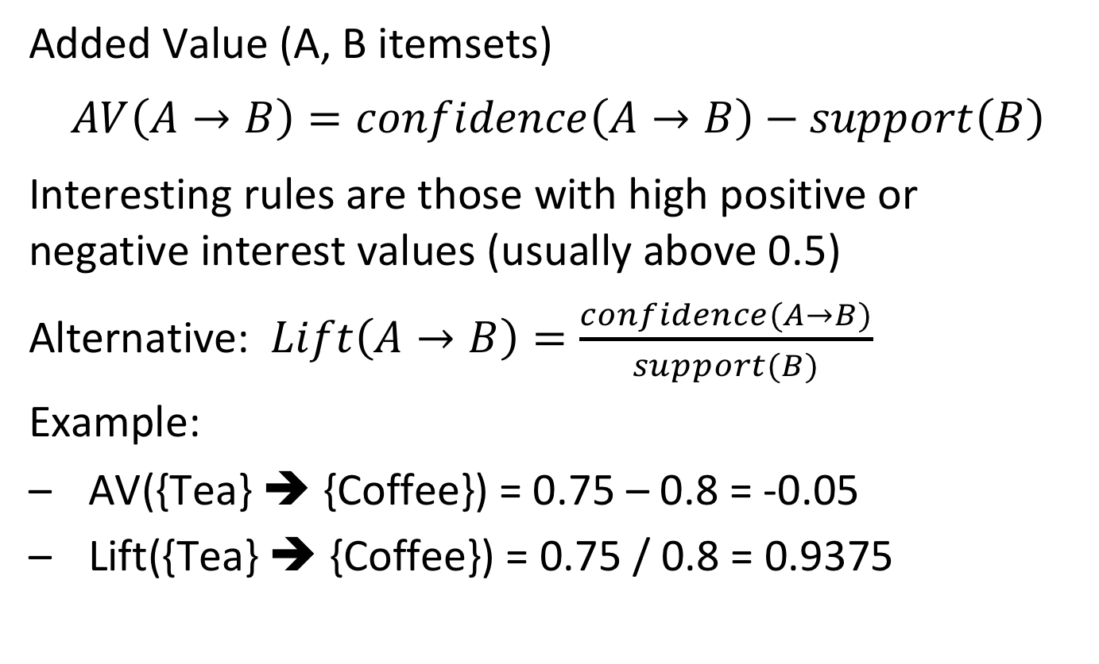
Alternative Measures of Interest
Added Value (A, B itemsets)
$$AV\left(A→B\right)=confidence\left(A→B\right)−support\left(B\right)$$
Interesting rules are those with high positive or negative interest values (usually above 0.5)
Alternative: $Lift\left(A→B\right)=\frac{confidence(A→B)}{support(B)}$
Example:
AV({Tea} ➔ {Coffee}) = 0.75 – 0.8 = -0.05
Lift({Tea} ➔ {Coffee}) = 0.75 / 0.8 = 0.9375
Notes:
The reason why the rule in the previous example was not interesting, was the high support for the head of the rule. The rule just states that, independent of the body, the itemset in the head is frequent. To account for that the level of support for the head can be incorporated into the confidence measure, resulting in two alternative measures of interest.
In the added value approach, the support is subtracted from the confidence, thus lowering the interestingness of a rule if the support for the head is high.
In the lift approach, the confidence is divided by the support of the head, also reducing the interestingness of a rule if the support for the head is high.
Lift is closely related to Added Value: note that lift (A-> B) = P(A,B) / P(A) P(B). That implies that if A and B are independent lift equals 1, and in that case added value equals 0. Added value converges to 1 when lift converges to infinity and added value converges to -1 when lift converges to 0.

Slide 44
Quantitative Attributes
Transforming quantitative (numeric ordered values) into categorical ones
Static discretisation into predefined bins
Dynamic discretisation based on the distribution of the data
The rules depend on the chosen discretisation!!
(1) age{x, [18,19]} ⋀ live{x, Lausanne} ➔ work{x, student}
(2) age{x, [20,21]} ⋀ live{x, Lausanne} ➔ work{x, student}
vs.
(1) age{x, [18,21]} ⋀ live{x, Lausanne} ➔ work{x, student}
Notes:
Association rules can also be derived for quantitative data. In order to obtain finite itemsets, the quantitative domains are transformed to discrete ones using discretization. Methods of discretization are widely used in machine learning for data preprocessing. Two basic approaches are static discretization, splitting the data in bins of uniform size, and dynamic discretization splitting the data in bins with uniform number of elements. Also, semantic aspects can be taken into consideration when performing discretization, as the example illustrates. A static discretization could create there bins that are semantically less meaningful.

Slide 45
Improving Apriori for Large Datasets
Transaction reduction
A transaction that does not contain any frequent k-itemset is useless in subsequent scans
Sampling
Mining on a sampled subset of DB, with a lower support
Partitioning (SON algorithm)
Any itemset that is potentially frequent in a DB must be frequent in at least one of the partitions of the DB
Notes:
Though the basic Apriori algorithm is designed to work efficiently for large datasets, there exist several possible improvements:
Transactions in the database that turn out to contain no frequent k-itemsets can be omitted in subsequent database scans.
The sampling method selects samples from the database and searches for frequent itemsets in the sampled database, using a correspondingly lower threshold for the support.
One identify first frequent itemsets in partitions of the database, that fit in memory. This method exploits the idea that if an itemset is not frequent in any of the partitions (local frequent itemset) then it is also not be frequent in the whole database.

Slide 46
Sampling
Approach
Randomly sample transactions with probability p
Detect frequent itemsets with support p*s
Eliminate false positives by counting frequent itemsets on complete data after discovery
Refinements
If we assume that the m transactions are randomly sorted, we can just choose the first p*m ones
False negatives can be reduced by choosing a lower threshold, e.g., 0.9 p*s
Notes:
Random sampling data before searching association rules must consider two issues: false positives and false negatives. False positives can be dealt with by verifying the support for the itemsets on the complete transaction set. For false negatives, no such possibility exists. By decreasing the support threshold, the number of false negatives can be reduced, at the cost of testing more candidate itemsets when scanning the complete dataset.
A further optimization can be achieved, when we know that the transactions occur in random order. Then sampling can be replaced by simple using the first p*m elements of the database, where m is the size of the database.

Slide 47
Partitioning
Approach
Divide transactions in 1/p partitions and repeatedly read partitions into main memory
Detect in-memory algorithm to find all frequent itemsets with support threshold p*s
An itemset becomes a candidate if it is found to be frequent in at least one partition
On a second pass, count all the candidate itemsets and determine which are frequent in the entire set of transactions
Notes:
With partitioning we are not sampling the dataset but processing the complete transaction set partition by partition. If an itemset is frequent in one partition (with a correspondingly adapted threshold), then it becomes a candidate. At this stage it is not sure that it is also frequent for the whole transaction set. Therefore, in a second pass itemsets that are frequent are determined by scanning the whole transaction database.

Slide 48
Partitioning – Why it works
Key “monotonicity” idea
an itemset cannot be frequent in the entire set of transactions unless it is frequent in at least one subset
Proof: If for all partitions support is below p*s, the total support is less than (1/p) p*s = s!
Notes:
The second pass is needed, since the condition of being frequent in at least one partition is necessary, but not sufficient.

Slide 49
Partitioning – Distributed Version
Partitioning lends itself to distributed data mining
Transactions distributed among many nodes
Compute frequent itemsets at each node
Distribute candidates to all nodes
Accumulate the counts of all candidates
MapReduce implementation!
Notes:
Partitioning is an embarrassingly parallel algorithm, and can therefore be naturally executed in a distributed environment, e.g., using Map-Reduce

Slide 50
A false negative in sampling can only occur for itemsets with support smaller than …
the threshold s
p*s
p*m
None of the above

Slide 51
5.2.3 FP Growth
Frequent itemset discovery without candidate itemset generation
Proceeds in 2 steps:
Build a data structure, called the FP-tree
Requires 2 passes over the dataset
Extract frequent itemsets directly from the FP-tree
Notes:
Though Apriori is as the original method the most popular association rule mining algorithm, other algorithms have been devised that attempt to provide better performance under certain circumstances. FP Growth is one example of such an algorithm that is mainly aiming at main memory implementations (and thus less suitable for distributed implementation). It does not generate candidates for frequent itemsets but constructs them directly using a data structure called FP-Tree. The FP-Tree allows to extract directly the association rules.

Slide 52
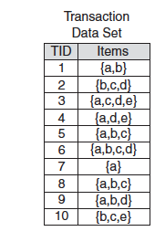
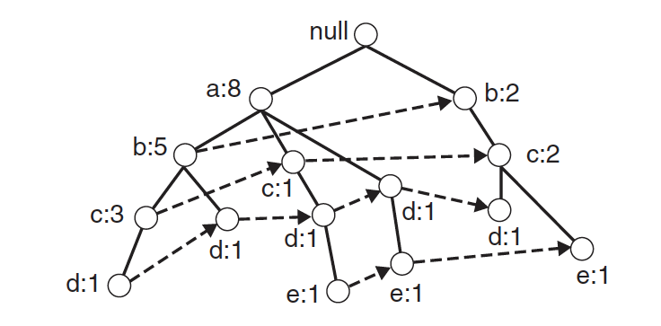
FP-Tree Data Structure
Itemset {b,c} occurs 5 times:
3 times with a
2 times without a
Itemset {a,b} occurs 5 times
Itemset {a,d} occurs 4 times
Items are sorted by decreasing support
Nodes correspond to single items
Counters indicate frequency of itemset from root to node
Different nodes for the same item are connected by a linked list
Notes:
The structure of an FP-Tree is comparable to that of a trie. In order to construct the FP-Tree, first items in the itemsets are sorted. The nodes in the tree correspond to items, and paths from the root correspond to itemsets. Itemsets sharing the same prefix of items, share the same path prefix in the tree. Counters at the nodes indicate how frequent the itemset corresponding to the path from the root to the node is. If we consider the left most path, we see that item a occurs 8 times, itemset ab 5 times, abc 3 times, and abcd once. The same item can occur in the tree in multiple places. The different occurrences are connected as linked list. For itemsets that occur in different paths (e.g., bc, which occurs together with a and without a), the frequencies can be computed by following the linked lists of the last item in the itemset and testing whether the remaining items are present in the path.

Slide 53
FP-Tree: Item Sorting
Item frequencies
a: 8
b: 7
c: 6
d: 5
e: 3
FP-Tree Size: The FP-Tree is more compact the more common prefixes the itemsets share
Sorting items by decreasing support increases this probability
Notes:
Sorting items in itemsets by decreasing support is an important heuristics to keep the FP-Tree compact, as more frequent items tend to be on the top of the tree which increases the likelihood that different itemsets share a common prefix. In the example the items were sorted already according to their frequencies. If it is not the case, they need to be reordered according to their frequencies.

Slide 54
Step 1: FP-Tree Construction
Requires 2 passes over the dataset
Pass 1: Compute support for each item
Pass over the transaction set
Sort items in order of decreasing support
Pass 2: Construct the FP-Tree data structure
Tree is expanded one itemset at a time
Notes:
To construct the FP-Tree one proceeds in two passes (not to confuse with the two steps of the overall FP-Growth algorithm mentioned in the beginning). In a first pass the transactions are scanned to compute the support for each single item. The items are then sorted in decreasing order. This order is being used to sort itemsets before the construction of the FP-Tree. In the second pass the FP-Tree is constructed by adding one itemset at a time.

Slide 55
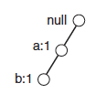
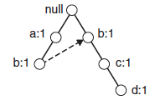
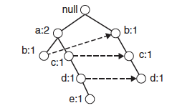
Step 1: FP-Tree Construction
Adding itemset 1
Adding itemset 2
Adding itemset 3
Notes:
Constructing the FP-Tree proceeds in a way analogous to constructing a trie structure. The itemsets in the transaction database are processed sequentially. The items in an itemset are processed one by one. If for the current item there exists already a node in the FP-Tree, no new node is created. If it does not exist, a new branch is created for the item. The number of occurrences is updated by 1 at each node that is visited (since each subset of the itemset is also an itemset). Finally, links are added between nodes with the same labels.

Slide 56
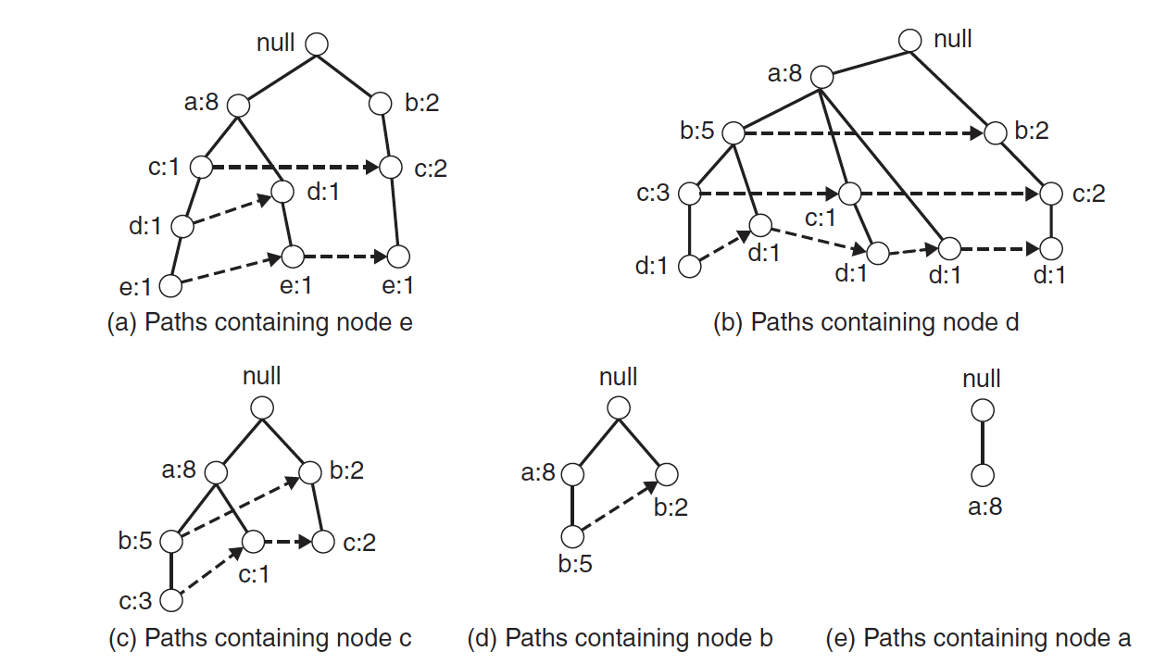
Step 2: Frequent Itemset Extraction
For each item extract the tree with paths ending in the item
- Used to find frequent itemsets containing the item
x
x
x
x
x
Removing all nodes not on a path to node e
Notes:
After the FP-Tree has been constructure in step 1, In the second step frequent itemsets are extracted from it. For each item, first a subtree is extracted from the full FP-Tree that contains only the paths ending in the item. For extracting those subtrees, the linked lists are helpful. One needs to traverse just the corresponding list and retain the paths from the traversed nodes to the root. The figures illustrates the resulting subtrees for the 5 items.

Slide 57
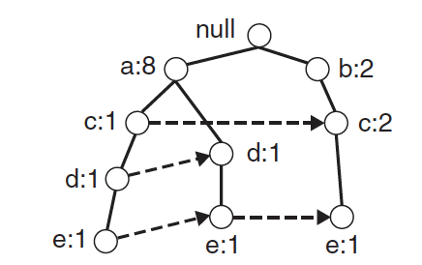
Step 2: Divide and Conquer Strategy
Start with item with lowest support (e.g., item e) and extract its tree
Check whether the item has sufficient support (e.g., 2)
Add up counts along the list of the item
e.g., item e has support 3
Notes:
For extracting frequent itemsets, the algorithm starts with the item that has the lowest support. It extracts its corresponding tree, as described before. Next the support of the item can be computed by traversing the leaves of the tree, following the links. In the example, item e would this have support 3. If the support is above threshold, then processing proceeds to find larger itemsets containing the item, otherwise processing can stop since no frequent itemsets containing this item can exist.

Slide 58
Step 2: Divide and Conquer Strategy
If item has sufficient support, check for itemsets ending in the item
Example: if item e is frequent check whether itemsets de, ce, be, ae are frequent
again, in order of lowest support
In order to check whether these itemsets are frequent compute a conditional FP-Tree
Notes:
If we find that the current item has sufficient support (e.g., item e), then we check next whether the itemsets consisting of two items and ending in the item have also sufficient support. For doing so we derive a conditional FP-Tree from the tree that we have constructed for the item before. The conditional tree is constructed in three steps:
First, the support counts in the tree are updated such that only the number of itemsets containing the current item is considered. This can be performed traversing the paths from the bottom to the root.
Second, the leaf nodes corresponding to the current item are removed
Finally, all nodes that have an insufficient support count are also removed from the conditional FP Tree

Slide 59
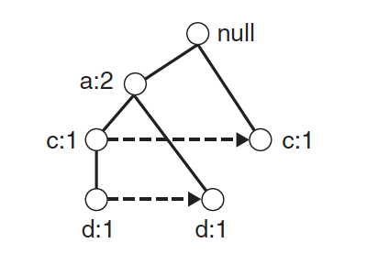
Conditional FP-Tree
Corresponds to the FP-Tree that would be built if
we only consider transactions containing a particular itemset
then omit this itemset (e.g., {e})
drop items that are not frequent in the subset of the transaction set (e.g., {b})
Notes:
One way to understand the construction of the conditional FP Tree is that it is the FP Tree that would be constructed when we only consider the transactions that consider the current item (or itemset) and then remove e and any non-frequent item from those itemsets. In the example this would be item e that we consider, and item b would be eliminated, since not frequent in the remaining transactions.

Slide 60
Deriving Conditional FP-Tree
The conditional FP-Tree can be derived from extracted tree
Update support counts to itemsets containing the item
Remove the nodes of the item
Remove nodes with insufficient support count
a:2
1
2
x
1
c:1
1
1
1
1
1
2,3
0
2,3
1
1
x
x
x
Notes:
Here we illustrate the constructing of the conditional FP-Tree for e. Note, when we update the support counts, for the node b:2, there are are two itemsets that contribute to the support count of b. The itemset {b} and the itemset {b,c,e}. Since only one of them contains the item e, the support count for b is changed to b. Similarly for a:8 and c:2. Since the total support for b drops below 2, the node is finally removed from the tree.

Slide 61
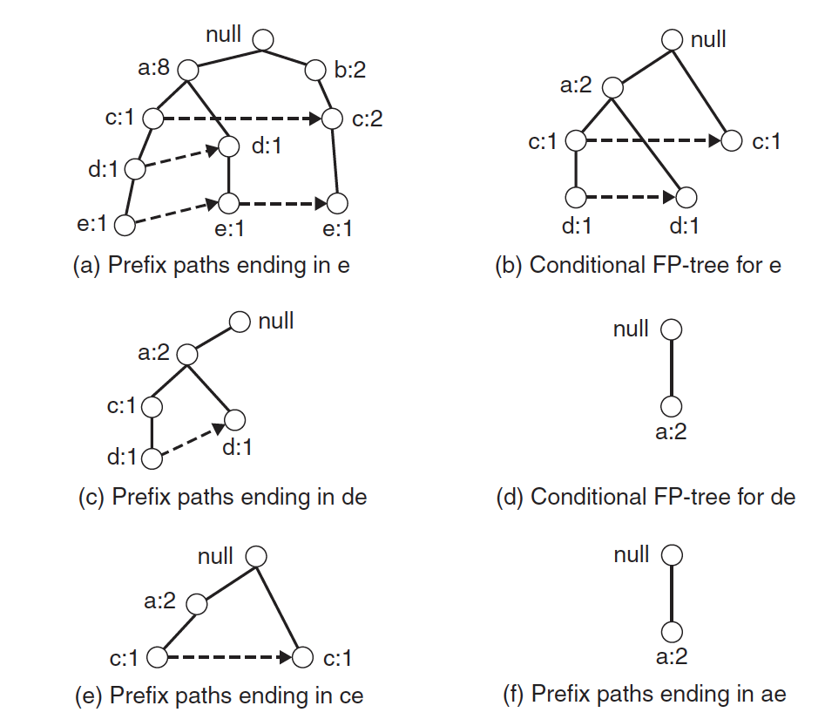
Conditional FP-Tree
2 paths ending in e
(sufficient support)
Item b has only
support count 1
(thus removed)
de has support count 2
ade has support count 2
ce has support count 2
ae has support count 2
Notes:
Here we show all conditional FP-Trees that would be constructed from 2-itemsets ending in item e. Once the conditional FP Trees have been constructed, we can read off the support for all 2-itemsets, by traversing the lists at the leaf level (as we did first for item e itself). Once this step is finished, the algorithm continues in the same way for the remaining 2-itemsets. For example, for itemset de we would now construct a conditional FP Tree, by first extracting from tree (b) the tree with paths ending in de, resulting in tree (c), and then extracting the conditional FP Tree for itemset de (tree (d)).

Slide 62
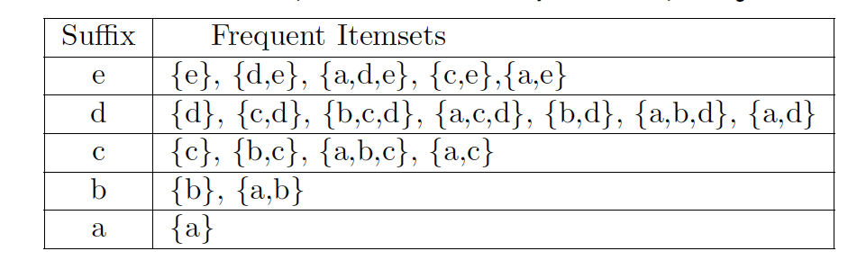
Result
Frequent itemsets detected in this order
Notes:
This table summarizes the frequent itemsets in the order they are detected, i.e., starting from the items with the lowest support. The first row contains exactly the itemsets containing the item e, in the order in which they are detected.

Slide 63
In the first pass over the database of the FP Growth algorithm
Frequent itemsets are extracted
A tree structure is constructed
The frequency of items is computed
Prefixes among itemsets are determined

Slide 64
The FP tree below is …
not valid, b is missing
not valid, since count at leaf level larger than 1
possible, with 2 transactions {a}
possible, with 2 transactions {a,c}
null
a:3
c:2

Slide 65
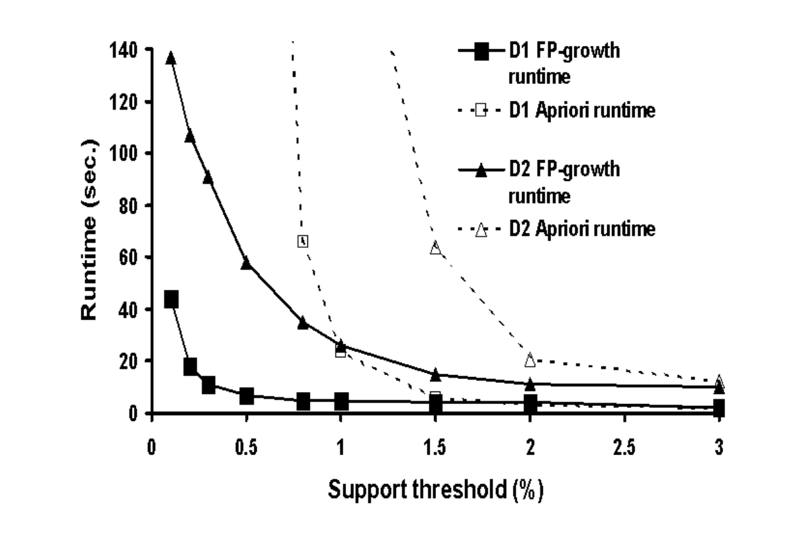
Performance Comparison
Notes:
This performance comparison shows the behavior of FP Growth as compared to apriori. As the support threshold gets smaller, and therefore more rules are detected, the runtime of both algorithms increases. For smaller thresholds, FP Growth exhibtis increasingly better performance as compared to apriori., whereas for larger thresholds the advantage is less pronounced and disappears.

Slide 66
Summary FP Growth
Advantages
Only 2 passes over the dataset
Compresses dataset
(Generally) much faster than Apriori
Disadvantages
Works less efficiently for high support thresholds
Must run in main memory
Difficult to find distributed implementation
Notes:
FP Growth Works less efficiently for high support thresholds, because it prunes only single items.

Slide 67
Components of Data Mining Algorithms
Pattern structure/model representation
association rules
Scoring function
support, confidence
Optimisation and search
JOIN, PRUNE
FP-Tree, ordering of items
Data management
transaction reduction, partitioning, sampling
Notes:
Our study of association rule mining nicely illustrates the 4 main aspects of every data mining algorithm. The model type and scoring function are common to all machine learning algorithms. When it comes to large datasets also algorithmic optimizations and efficient management of large datasets become important questions.

Slide 68
References
Textbook
http://www.mmds.org/mmds/v2.1/ch06-assocrules.pdf
Jiawei Han, Data Mining: concepts and techniques, Morgan Kaufman, 2000, ISBN 1-55860-489-8
Pang-Ning Tan, Michael Steinbach, Vipin Kumar: Introduction to Data Mining, Addison-Wesley. Chapter 6: Association Analysis: Basic Concepts and Algorithms
Some relevant research literature
R. Agrawal, T. Imielinski, and A. Swami. Mining association rules between sets of items in large databases. SIGMOD'93, 207-216, Washington, D.C.
J. Han, J. Pei and Y. Yin. Mining Frequent patterns without candidate generation. SIGMOD 2000, 1–12.

